Slide 1
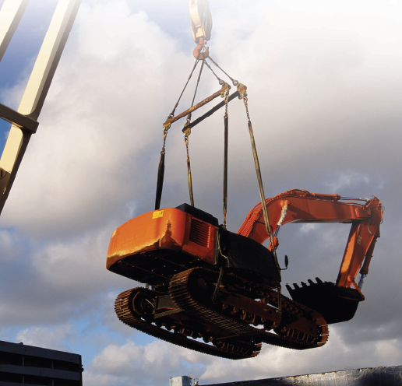
Engineering Mechanics Lecture-3

Slide 2
Force and system of forces
Force System
Simpler way of describing very complex physical interaction between bodies.
Resultant

Slide 3
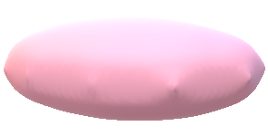


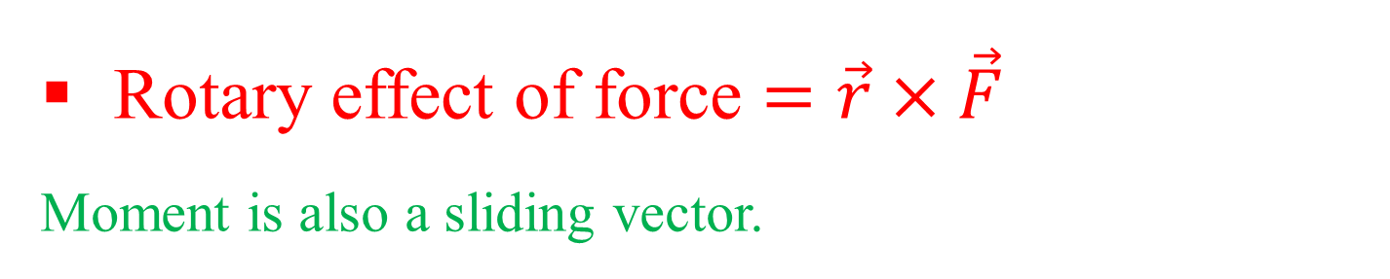



Moment of a force
$$O$$
Force can be used as sliding vector. Translation or rotation can be produced by force.
Sign Convention
+ve anticlockwise moment
-ve clockwise moment
$$F$$
$$r$$
$$P$$
$$O^{′}$$
Rotary effect of force $=\vec{r}×\vec{F}$
Moment is also a sliding vector.

Slide 4


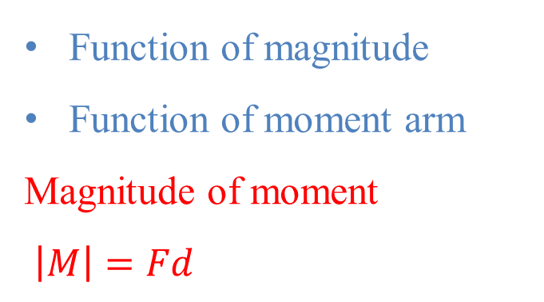






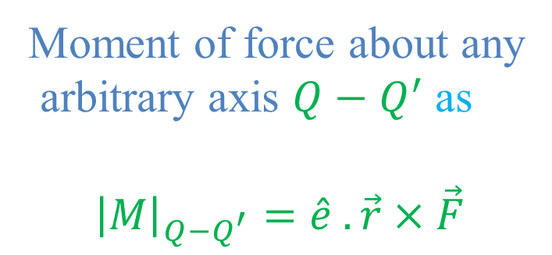


Moment of a force
$$O$$
Function of magnitude
Function of moment arm
Magnitude of moment
$\left|M\right|=Fd$
$$F$$
$$r$$
$$P$$
$$d$$
$$Q$$
$$O$$
$$O^{′}$$
$$F$$
$$\hat{e}$$
Moment of force about any
arbitrary axis ${Q−Q}^{′}$ as
$${\left|M\right|}_{{Q−Q}^{′}}=\hat{e} . \vec{r}×\vec{F}$$
$$r$$
$$P$$
$$d$$
$$O^{′}$$
$$Q^{′}$$

Slide 5
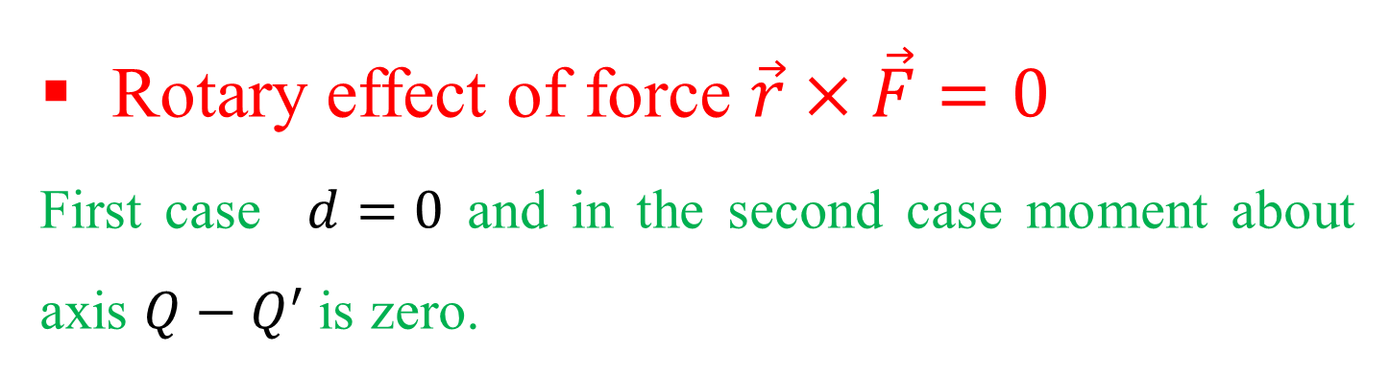




Moment of a force vanishes 
$$O$$
$$Q$$
$$F_{2}$$
$$F_{1}$$
If line of action of force cuts the axis.
Line of action is parallel to the axis.
$$r$$
$$P$$
$$O^{′}$$
$$Q^{′}$$
Rotary effect of force $\vec{r}×\vec{F}=0$
First case $d=0$ and in the second case moment about axis ${Q−Q}^{′}$is zero.

Slide 6

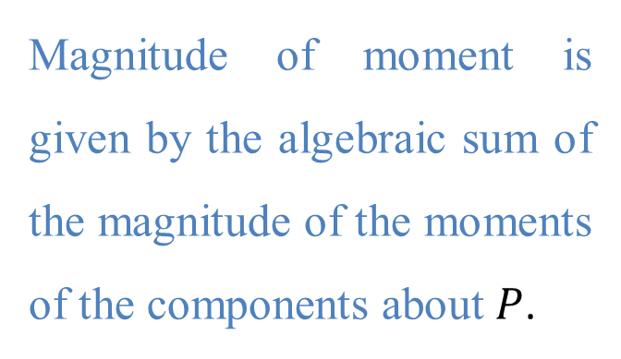



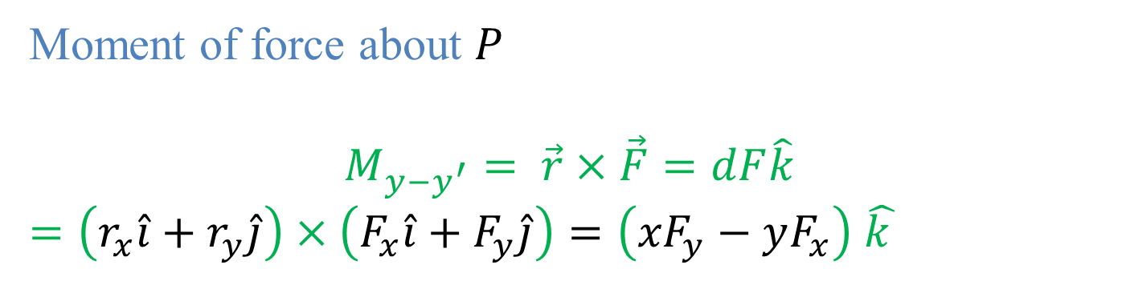

Varignon’s theorem
$$z$$
$$F=F_{x}\hat{i}+F_{y}\hat{j}$$
Magnitude of moment is given by the algebraic sum of the magnitude of the moments of the components about $P$.
$$r=r_{x}\hat{i}+r_{y}\hat{j}$$
$$F$$
$$P$$
$$d$$
$$z^{′}$$
Moment of force about $P$
$$M_{{y−y}^{′}}= \vec{r}×\vec{F}=dF\hat{k}$$
$=\left(r_{x}\hat{i}+r_{y}\hat{j}\right)×$ $\left(F_{x}\hat{i}+F_{y}\hat{j}\right)=\left({xF}_{y}−yF_{x}\right)$ $\hat{k }$

Slide 7

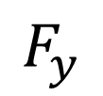





Sample Problem
$$3 m$$
$$F_{x}$$
$${45}^{0}$$
$$4 m$$
$$F=500 N$$
$$O$$
$$F_{y}$$

Slide 8






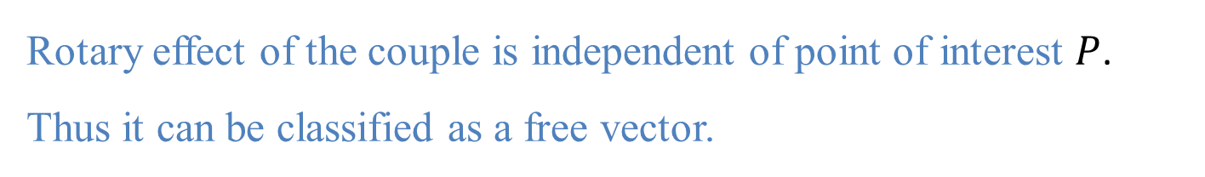
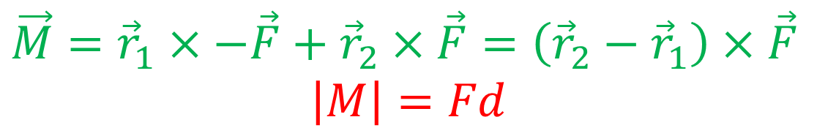


Moment of couple
$$M$$
Two equal and parallel but non collinear force with opposite sense forms a couple.
$$F$$
$$r_{2}$$
$$P$$
$$r_{1}$$
$$a$$
$$F$$
$$d$$
$$y^{′}$$
$\vec{M}={\vec{r}}_{1}×−\vec{F}+{\vec{r}}_{2}×\vec{F}=\left({\vec{r}}_{2}−{\vec{r}}_{1}\right)$ $×\vec{F}$
$$\left|M\right|=Fd$$
Rotary effect of the couple is independent of point of interest $P$.
Thus it can be classified as a free vector.

Slide 9













Resolution of a force to force and a couple
$$F$$
$$F$$
$$F$$
$$P$$
$$P$$
$$d$$
$$d$$
$$F$$
$$y^{′}$$
$$M$$
$$F$$
$$P$$
$$y^{′}$$

Slide 10








Resultant of a system of force
$$F$$
$$M$$
$$P$$
$$d$$
$$P$$
$$M$$
$$R$$
$$P$$

Slide 11
Vector and Scalar
Vector: parameters possessing magnitude and direction which add according to the parallelogram law.
Examples: displacements, velocities, accelerations, forces.
Fixed or bound vectors have well defined points of application that cannot be changed without affecting an analysis.
Free vectors may be freely moved in space without changing their effect on an analysis.
Sliding vectors may be applied anywhere along their line of action without affecting an analysis.
Scalar: parameters possessing magnitude but not direction.
Examples: mass, volume, temperature, work, energy

Slide 12




















Vector addition/ subtraction
$R^{2}=P^{2}$+$Q^{2}−2PQ\cos{θ}$
$$R$$
$$\vec{R}=\vec{P}+\vec{Q}$$
$$Q$$
$$θ^{0}$$
$R^{2}=P^{2}$+$Q^{2}+2PQ\cos{θ}$
$$P$$
$$R$$
$$\vec{R}=\vec{P}+\vec{Q}=\vec{Q}+\vec{P}$$
$$Q$$
It follows commutative law
$$θ^{0}$$
$$\vec{R}=\vec{P}−\vec{Q}$$
$$P$$
$$R$$
$$R$$
$$Q$$
$$Q$$
$$θ^{0}$$
$$P$$
$$P$$

Slide 13







Sine law
$$α^{0}$$
$$\frac{P}{\sin{α}}=\frac{Q}{\sin{β}}=\frac{R}{\sin{γ}}$$
$$R$$
$$Q$$
$$γ^{0}$$
$$β^{0}$$
$$P$$

Slide 14
Acknowledgement
NPTEL lectures on Engineering Mechanics
en.wikipedia.org/wiki/History_of_science
britannica.com/technology/history-of-flight
Beer & Johnston, Vector Mechanics for Engineers
Meriam & Kraige, Engineering Mechanics

Slide 15
Any Questions
⬧

Slide 16
Engineering Mechanics Work sheet-1 Lecture-4

Slide 17
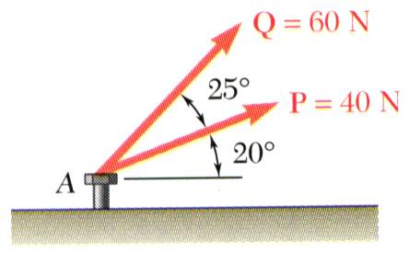
Problem 1.
The two forces act on a bolt at A. Determine their resultant.

Slide 18
Problem 2.
The two forces act on a bolt at A. Determine their resultant.

Slide 19
Problem 1.

Slide 20
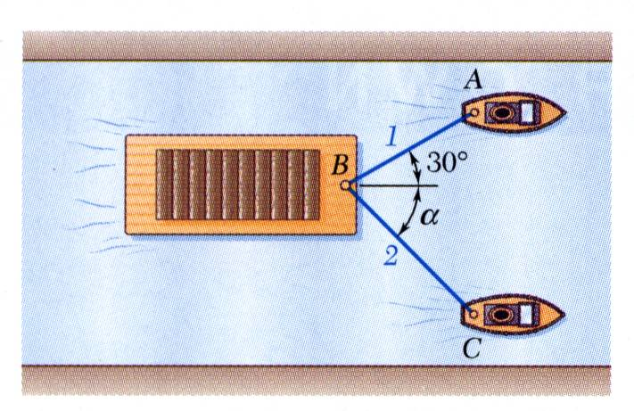
Problem 2.
A barge is pulled by two tugboats. If the resultant of the forces exerted by the tugboats is 5000 lbf directed along the axis of the barge, determine the tension in each of the ropes for α = 45º.

Slide 21
Problem 2.
At what value of α would the tension in rope 2 be a minimum?
Hint: Use the triangle rule and think about how changing α changes the magnitude of T₂.
The minimum tension in rope 2 occurs when T₁ and T₂ are perpendicular.

Slide 22
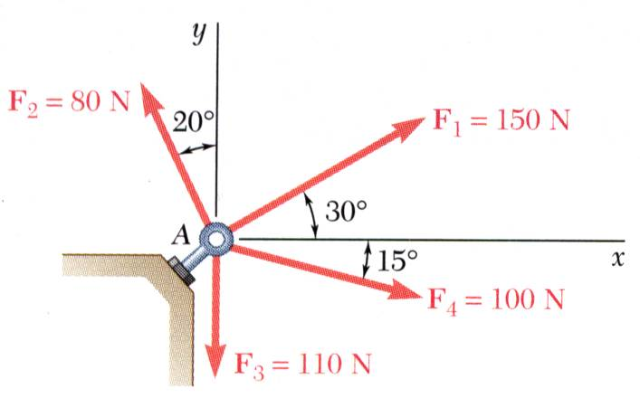
Problem 2.
Four forces act on bolt A as shown. Determine the resultant of the force on the bolt.

Slide 23
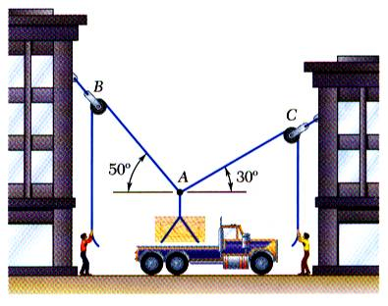





Free body diagram vs. space diagram
$$T_{AB}$$
$$T_{AC}$$
$${50}^{0}$$
$${45}^{0}$$
$$W$$
Space Diagram: A sketch showing the physical conditions of the problem, usually provided with the problem statement, or represented by the actual physical situation.
Free Body Diagram: A sketch showing only the forces on the selected particle.

Slide 24
Free body diagram
A sketch is drawn by removing the supporting surface.
Indicate all the applied/active forces that set the body in motion. Ex. weight of the body or applied force etc.
Indicate the reactive forces, such as those caused by constrained or support that prevents motion.
All the dimensions and angles, reference axis are shown in the sketch.

Slide 25




Free body diagram
$$α^{0}$$
$$β^{0}$$
$$α^{0}$$
$$β^{0}$$

Slide 26
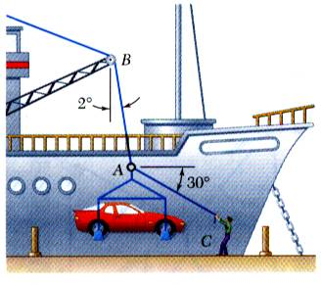
Free body diagram
In a ship-unloading operation, a 3500-lb automobile is supported by a cable. A rope is tied to the cable and pulled to center the automobile over its intended position. What is the tension in the rope?

Slide 27
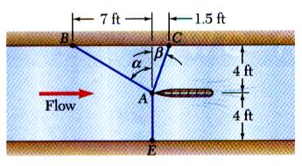
Free body diagram
It is desired to determine the drag force at a given speed on a prototype sailboat hull. A model is placed in a test channel and three cables are used to align its bow on the channel centerline. For a given speed, the tension is 40 lb in cable AB and 60 lb in cable AE.
Determine the drag force exerted on the hull and the tension in cable AC.

Slide 28
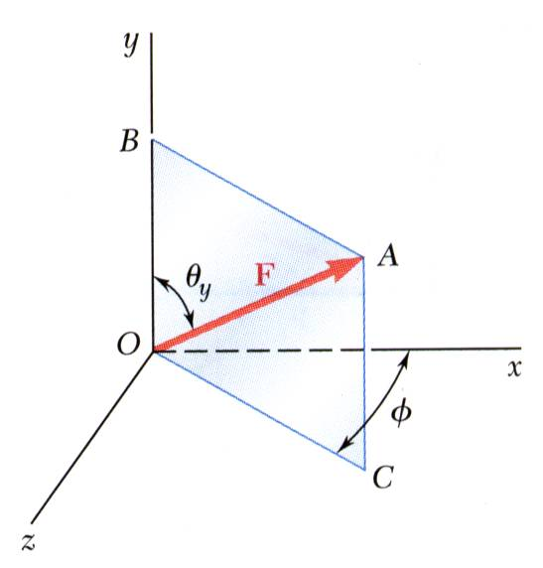
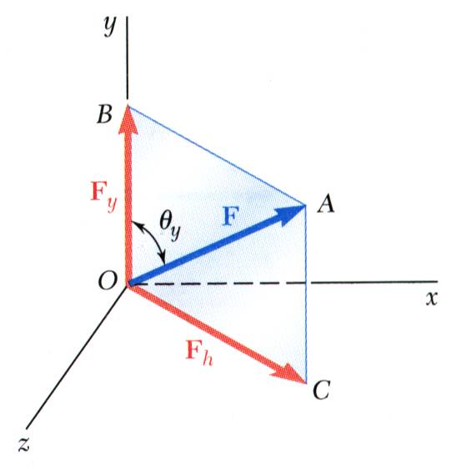
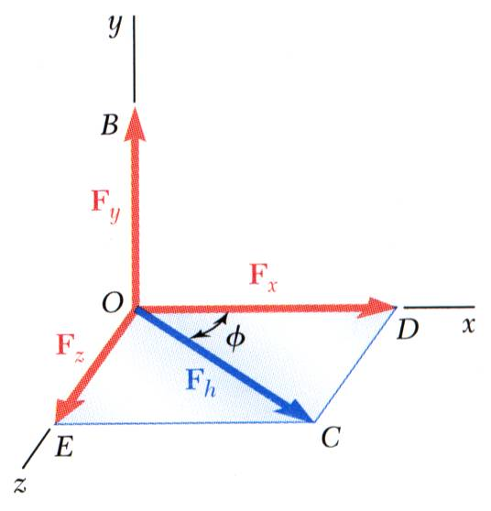
3-D Space

Slide 29
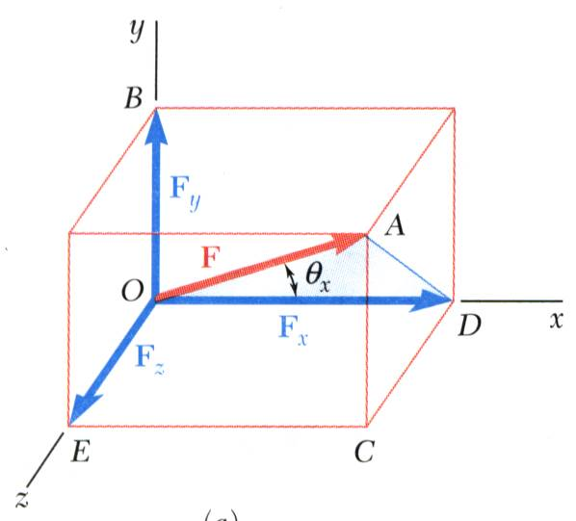
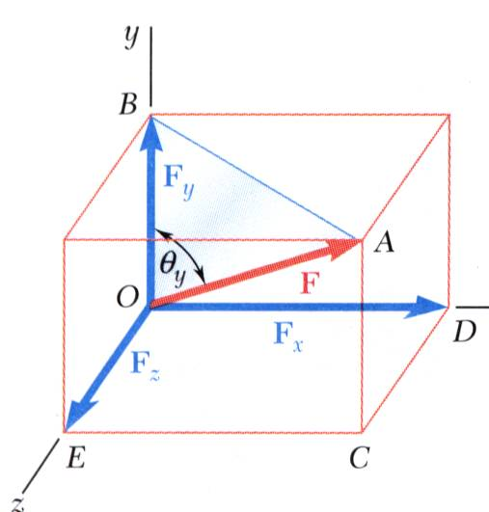
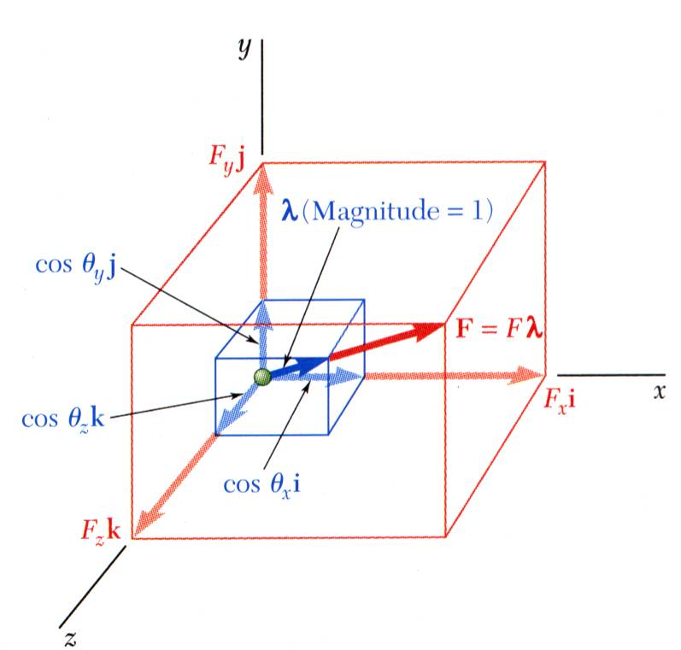
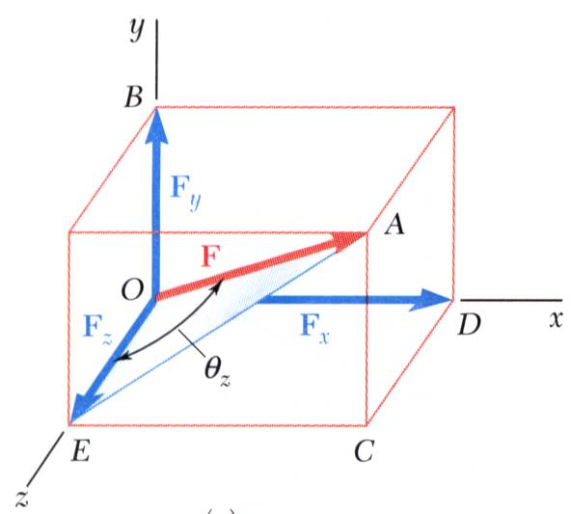
3-D Space

Slide 30
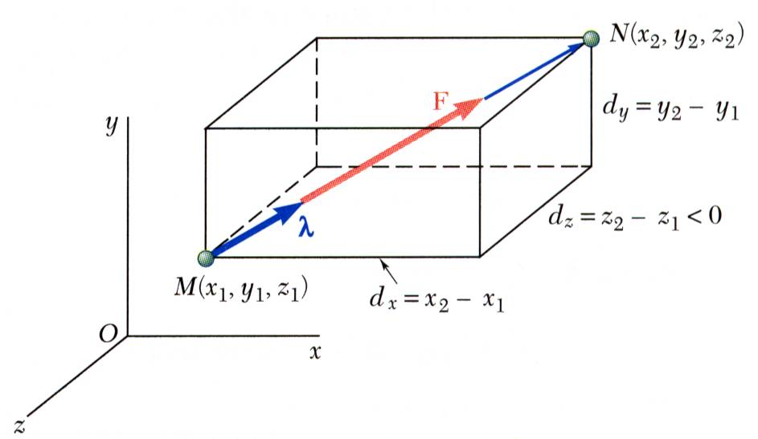
3-D Space

Slide 31
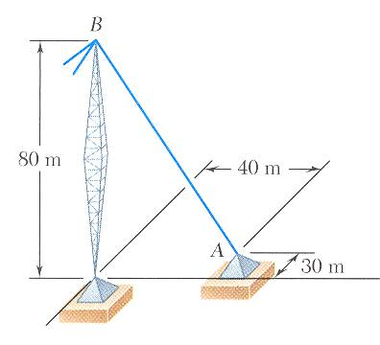
3-D Space
The tension in the guy wire is 2500 N. Determine:
a) components F_{x}, F_{y}, F_{z} of the force acting on the bolt at A,
b) the angles θ_{x}, θ_{y}, θ_{z} defining the direction of the force (the direction cosines)

Slide 32
Acknowledgement
NPTEL lectures on Engineering Mechanics
en.wikipedia.org/wiki/History_of_science
britannica.com/technology/history-of-flight
Beer & Johnston, Vector Mechanics for Engineers
Meriam & Kraige, Engineering Mechanics

Slide 33
Any Questions
⬧

